Slide 1
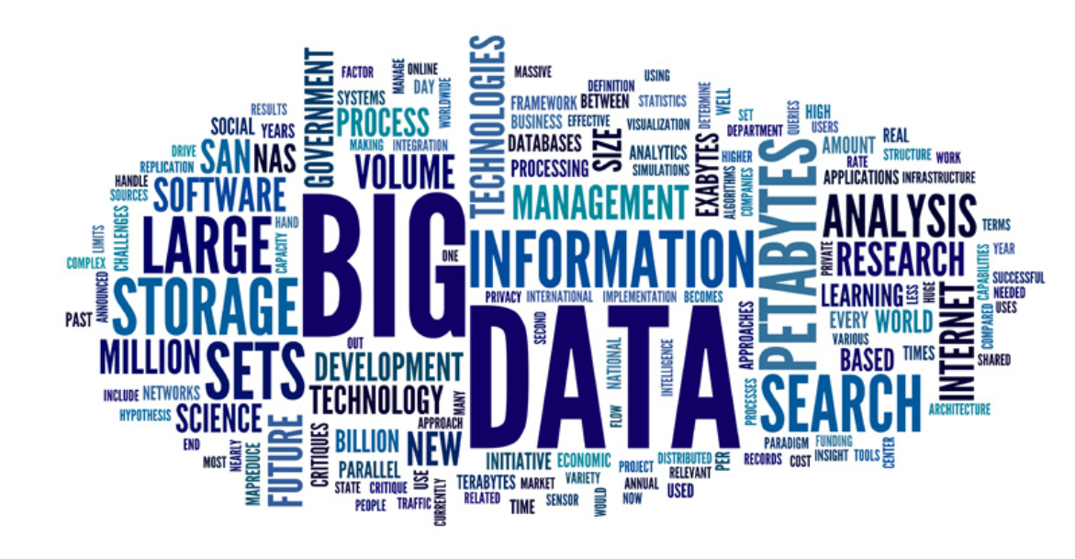
Introduction to Big-Data
Fundamentals of Big Data

Slide 2
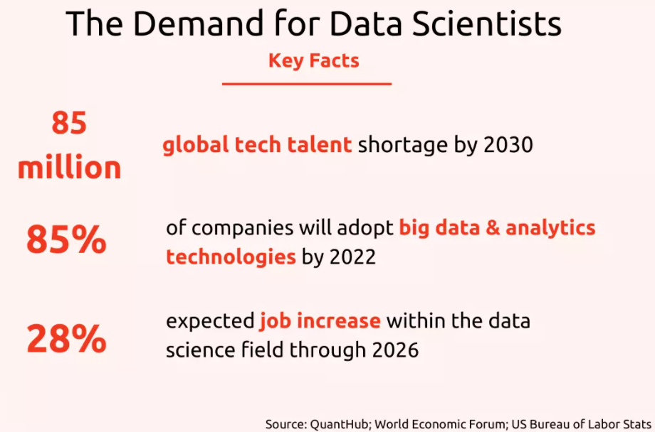

Slide 3
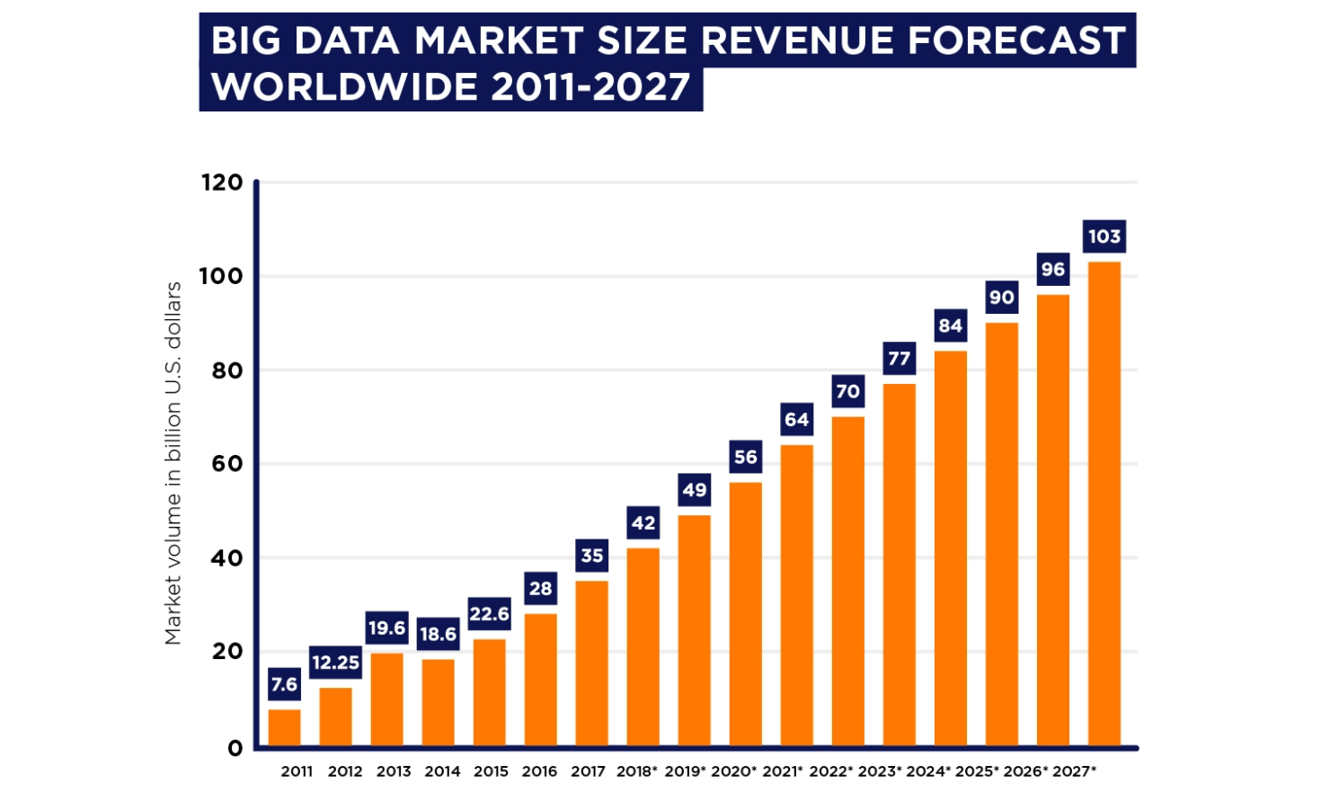

Slide 4
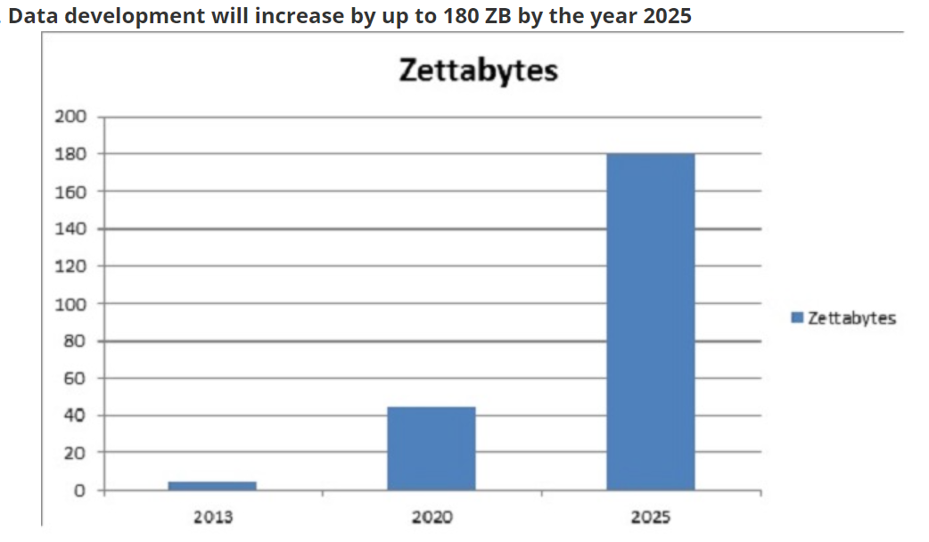

Slide 5
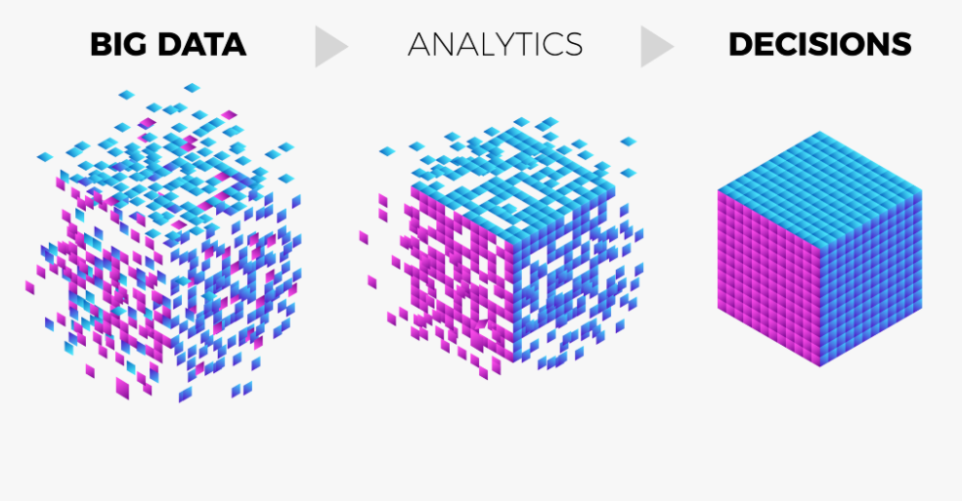
Extremely large data sets that may be analyzed computationally to reveal patterns, trends, and associations, especially relating to human behavior and interactions.

Slide 6
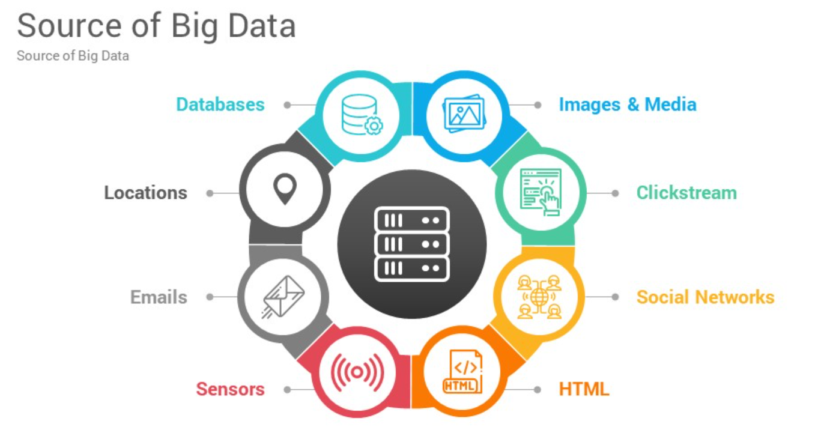

Slide 7
A significant part of big data is generated from three primary resources:
Machine data
Machine data is automatically generated, either as a response to a specific event or a fixed schedule.
It means all the information is developed from multiple sources such as smart sensors, SIEM logs, medical devices and wearables, road cameras, IoT devices, satellites, desktops, mobile phones, industrial machinery, etc
Social data,
It is derived from social media platforms through tweets, retweets, likes, video uploads, and comments shared on Facebook, Instagram, Twitter, YouTube, Linked In etc.
Transactional data.
Transactional data is information gathered via online and offline transactions during different points of sale.
Payment orders
Invoices
Storage records and
E-receipts

Slide 8
Quick Quiz?
Big data is-
A data science software
A data analysis software
Both of them
None of them

Slide 9
Understanding Big Data
Big Data is a field dedicated to the analysis, processing, and storage of large collections of data that frequently originate from disparate sources.
Big Data solutions and practices are typically required when traditional data analysis, processing and storage technologies and techniques are insufficient.
Specifically, Big Data addresses distinct requirements, such as the combining of multiple unrelated datasets, processing of large amounts of unstructured data and harvesting of hidden information in a time-sensitive manner

Slide 10
Different branches of analytics used in extracting insights from big data.
1. Marketing Analytics
It gives valuable information for improving a brand’s marketing campaigns, promotional offers and other consumer outreach.
2. Comparative Analysis
It looks into customer behaviour metrics and enables real-time engagement with customers so that enterprises can compare brands, products, services and business performance with their competitors.
This analysis requires the following type of data:
Demographic data
Transactional data
Web behaviour data
Consumer text data from surveys, feedback forms etc.
3. Sentiment Analysis
It focuses on customer feedback on a specific product or service, customer satisfaction, and pointers to improve in these areas.
4. Social Media Analysis
.This analysis is about people’s responses over social media platforms regarding their choices and preferences over a particular service or product.
This analysis helps businesses identify possible problems and target the correct audiences for all their marketing campaigns.

Slide 11
CONT…
The management and analysis of large datasets has been a long-standing problem.
Big Data science has evolved from these roots.
The analysis of Big Data datasets is an interdisciplinary endeavor that blends mathematics, statistics, computer science and subject matter expertise.

Slide 12
CONT…
Thirty years ago, one gigabyte of data could amount to a Big Data problem and require special purpose computing resources.
Now, gigabytes of data are commonplace and can be easily transmitted, processed and stored on consumer-oriented devices.

Slide 13
Big Data Use-Cases
After learning what is analytics. Let us now discuss various use cases of Big data. Below are some of the Big data use cases from different domains:
Netflix Uses Big Data to Improve Customer Experience
Promotion and campaign analysis by Sears Holding
Sentiment analysis
Customer Churn analysis
Predictive analysis
Real-time ad matching and serving

Slide 14
The results obtained through the processing of Big Data can lead to a wide range of insights and benefits, such as:
operational optimization
actionable intelligence
identification of new markets
accurate predictions
fault and fraud detection
improved decision-making
scientific discoveries

Slide 15
Big Data Technologies
There are lots of technologies to solve the problem of Big data Storage and processing.
Such technologies are Apache Hadoop, Apache Spark, Apache Kafka, etc.
Let’s take an overview of these technologies in one by one-

Slide 16

i. Apache Hadoop
Apache Hadoop is an open source framework that is used to efficiently store and process large datasets ranging in size from gigabytes to petabytes of data.
Instead of using one large computer to store and process the data, Hadoop allows clustering multiple computers to analyze massive datasets in parallel more quickly.
Big data is creating a Big impact on industries today. Therefore the world’s 50% of the data has already been moved to Hadoop.
It is predicted that by 2017, more than 75% of the world’s data will be moved to Hadoop and this technology will be the most demanding in the market as it is now.

Slide 17

ii. Apache Spark
Further enhancement of this technology has led to an evolution of Apache Spark – lightning fast and general purpose computation engine for large-scale processing.
It can process the data up to 100 times faster than MapReduce.
Apache Spark is an open-source, distributed processing system used for big data workloads.
It utilizes in-memory caching, and optimized query execution for fast analytic queries against data of any size.

Slide 18

Apache Kafka
Apache Kafka is another addition to this Big data Ecosystem which is a high throughput distributed messaging system frequently used with Hadoop.
Kafka is primarily used to build real-time streaming data pipelines and applications that adapt to the data streams.
It combines messaging, storage, and stream processing to allow storage and analysis of both historical and real-time data.
IT organizations have started considering Big data initiative for managing their data in a better manner, visualizing this data, gaining insights of this data as and when required and finding new business opportunities to accelerate their business growth.
telecom domain, banking domain, retail or healthcare domain etc.

Slide 19
Quick Quiz?
Big data means-
Very large amount of data
The data which has some importance to a business
Both of them
None of them

Slide 20
What are the best Big Data Tools?
Here is the list of top 10 big data tools –
Apache Hadoop
Apache Spark
Flink
Apache Storm
Apache Cassandra
MongoDB
Kafka
Tableau
RapidMiner
R Programming

Slide 21
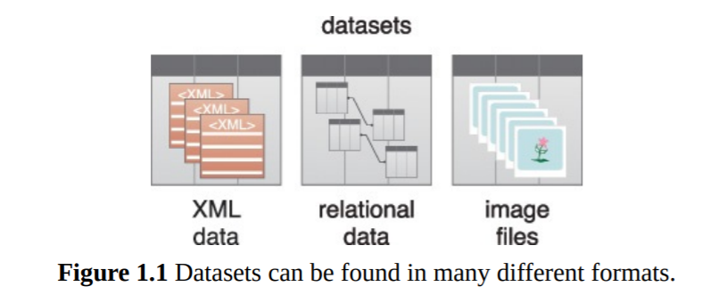
Datasets
Collections or groups of related data are generally referred to as datasets. Each group or dataset member (datum) shares the same set of attributes or properties as others in the same dataset.
A data set (or dataset) is a collection of data. In the case of tabular data, a data set corresponds to one or more database tables, where every column of a table represents a particular variable, and each row corresponds to a given record of the data set in question.
Some examples of datasets are:
• tweets stored in a flat file
• a collection of image files in a directory
• an extract of rows from a database table stored in a CSV formatted file
• historical weather observations that are stored as XML files

Slide 22
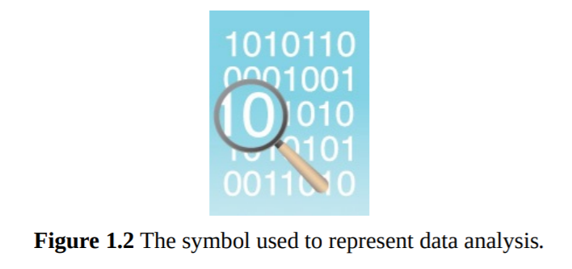
Data Analysis
Data analysis is the process of examining data to find facts, relationships, patterns, insights and/or trends.
The overall goal of data analysis is to support better decision making.
Ex: “how the number of ice cream cones sold is related to the daily temperature?”

Slide 23
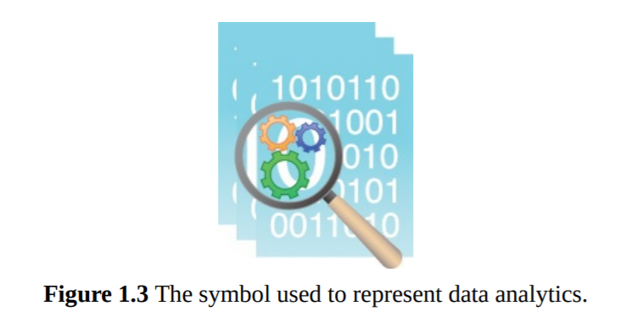
Data Analytics
Data analytics is a discipline that includes the management of the complete data lifecycle, which encompasses collecting, cleansing, organizing, storing, analyzing and governing data.
Big Data Analytics
The Big Data analytics lifecycle generally involves identifying, procuring, preparing and analyzing large amounts of raw, unstructured data to extract meaningful information that can serve as an input for identifying patterns, enriching existing enterprise data and performing large-scale searches.

Slide 24
Different kinds of organizations use data analytics tools and techniques in different ways. Take, for example, these three sectors:
• In business-oriented environments, data analytics results can lower operational costs and facilitate strategic decision-making.
• In the scientific domain, data analytics can help identify the cause of a phenomenon to improve the accuracy of predictions.
• In service-based environments like public sector organizations, data analytics can help strengthen the focus on delivering high-quality services by driving down costs.

Slide 25
Quick Quiz
For large scale processing in big data which one is more suitable?
Spark
B. Kafka
C. Mapreduce
D. hadoop

Slide 26
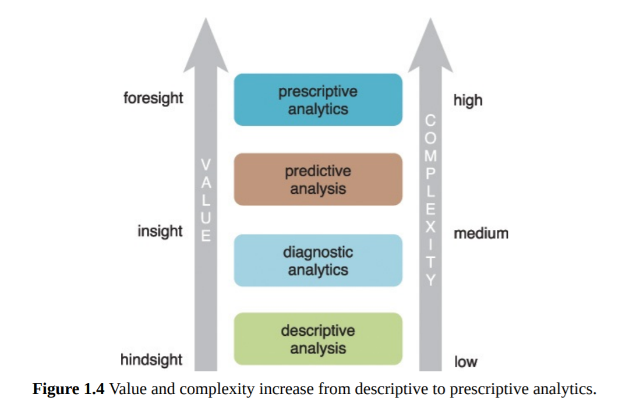
General categories of analytics
• Descriptive analytics
• Diagnostic analytics
• Predictive analytics
• Prescriptive analytics

Slide 27
Descriptive Analytics
What happened?
Descriptive analytics are carried out to answer questions about events that have already occurred.
This form of analytics contextualizes data to generate information.
Sample questions can include:
• What was the sales volume over the past 12 months?
• What is the number of support calls received as categorized by severity and geographic location?
• What is the monthly commission earned by each sales agent?
It is estimated that 80% of generated analytics results are descriptive in nature.
Value wise, descriptive analytics provide the least worth and require a relatively basic skill set.

Slide 28
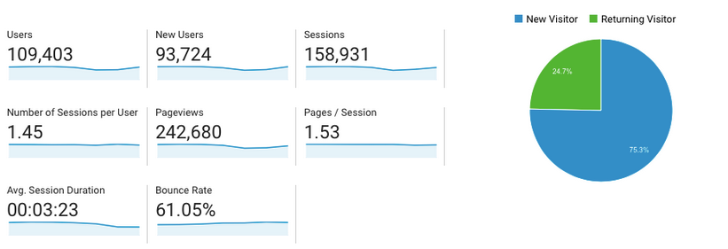
Describe what has happened;
it doesn’t try to explain why this might have happened or to establish cause-and-effect relationships
Google Analytics is a good example of descriptive analytics in action;
it provides a simple overview of what’s been going on with your website, showing you how many people visited in a given time period, for example, or where your visitors came from.

Slide 29
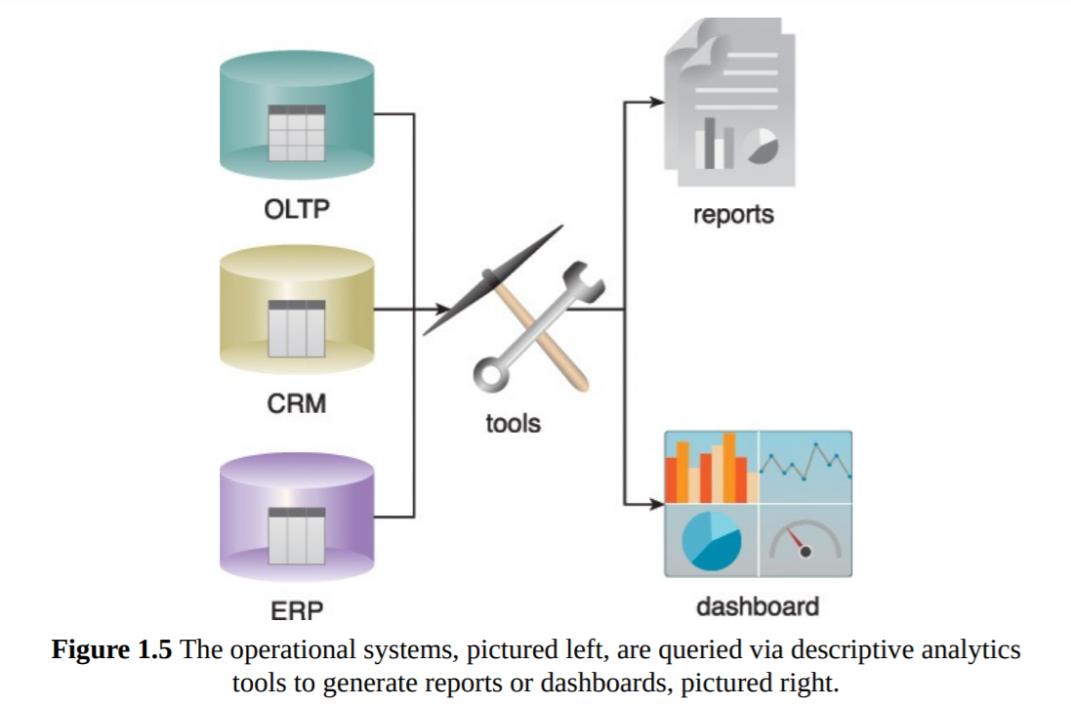
Descriptive analytics are often carried out via ad-hoc reporting or dashboards
There are two main techniques used in descriptive analytics:
Data aggregation is the process of gathering data and presenting it in a summarized format.
Data Mining: the analyst explores the data in order to uncover any patterns or trends.
The outcome of descriptive analysis is a visual representation of the data—as a bar graph, for example, or a pie chart.
This is often the starting point for more in-depth analysis

Slide 30
Diagnostic Analytics
Why did it happen?
Diagnostic Analytics aim to determine the cause of a phenomenon that occurred in the past using questions that focus on the reason behind the event.
Such questions include:
• Why were Q2 sales less than Q1 sales?
• Why have there been more support calls originating from the Eastern region than from the Western region?
• Why was there an increase in patient re-admission rates over the past three months? ind the event.
Diagnostic analytics results are viewed via interactive visualization tools that enable users to identify trends and patterns.

Slide 31
The main purpose of diagnostic analytics is to identify and respond to anomalies within your data.
For example: If your descriptive analysis shows that there was a 20% drop in sales for the month of March, you’ll want to find out why. The next logical step is to perform a diagnostic analysis.
Diagnostic analytics isn’t just about fixing problems, though; you can also use it to see what’s driving positive results.
When running diagnostic analytics, there are a number of different techniques that you might employ, such
Probability theory,
Regression analysis,
Filtering,
Time-series analysis, etc.

Slide 32
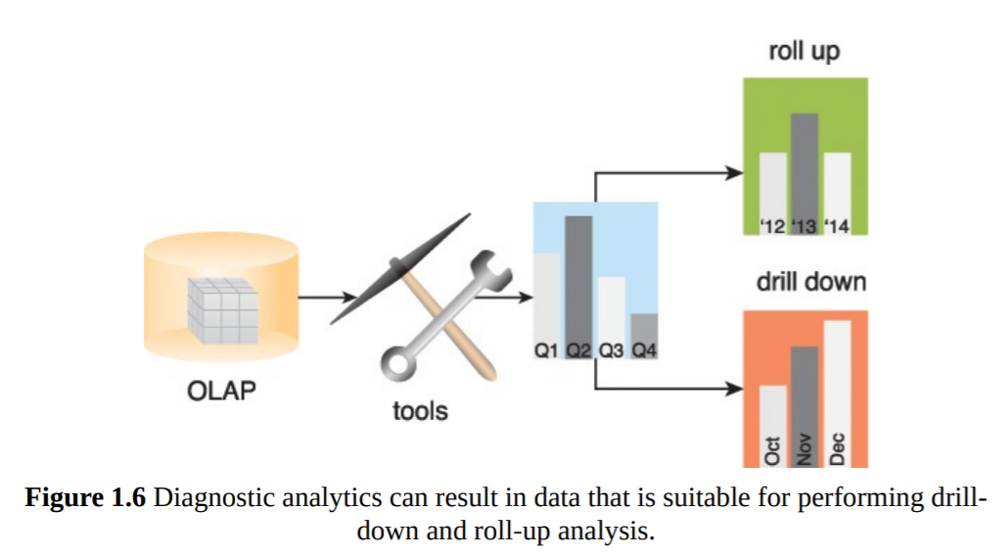
Diagnostic analytics usually require collecting data from multiple sources and storing it in a structure that lends itself to performing drill-down and roll-up analysis

Slide 33
Predictive analytics
What is likely to happen in the future?
Predictive analytics are carried out in an attempt to determine the outcome of an event that might occur in the future.
Questions are usually formulated using a what-if rationale, such as the following:
• What are the chances that a customer will default on a loan if they have missed a monthly payment?
• What will be the patient survival rate if Drug B is administered instead of Drug A?
• If a customer has purchased Products A and B, what are the chances that they will also purchase Product C?
Predictive analytics try to predict the outcomes of events, and predictions are made based on patterns, trends and exceptions found in historical and current data.
Classification and regression, ML and DL models

Slide 34
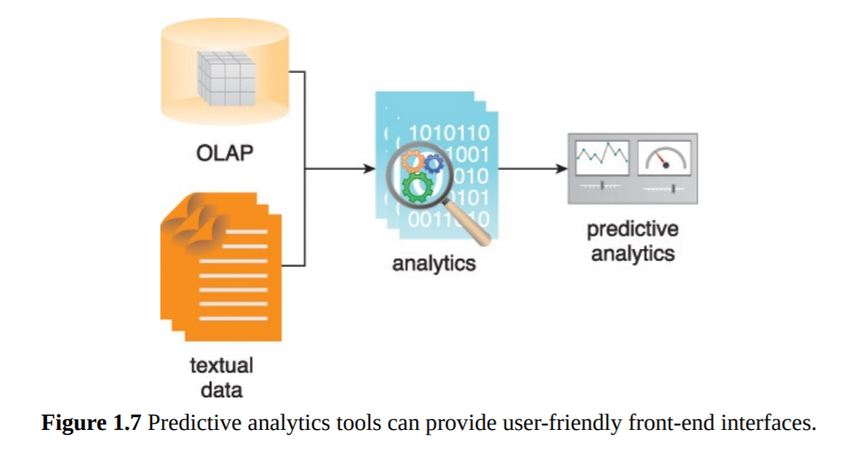

Slide 35
Prescriptive analytics
What’s the best course of action?
Prescriptive analytics looks at what has happened, why it happened, and what might happen in order to determine what should be done next.
Prescriptive analytics build upon the results of predictive analytics by prescribing actions that should be taken.
Sample questions may include:
• Among three drugs, which one provides the best results?
• When is the best time to trade a particular stock?

Slide 36
What steps can you take to avoid a future problem?
What can you do to capitalize on an emerging trend?
Prescriptive analytics is, without doubt, the most complex type of analysis, involving algorithms, machine learning, statistical methods, and computational modeling procedures.
An oft-cited example of prescriptive analytics in action is maps and traffic apps. When figuring out the best way to get you from A to B, Google Maps will consider all the possible modes of transport (e.g. bus, walking, or driving), the current traffic conditions and possible roadworks in order to calculate the best route.

Slide 37
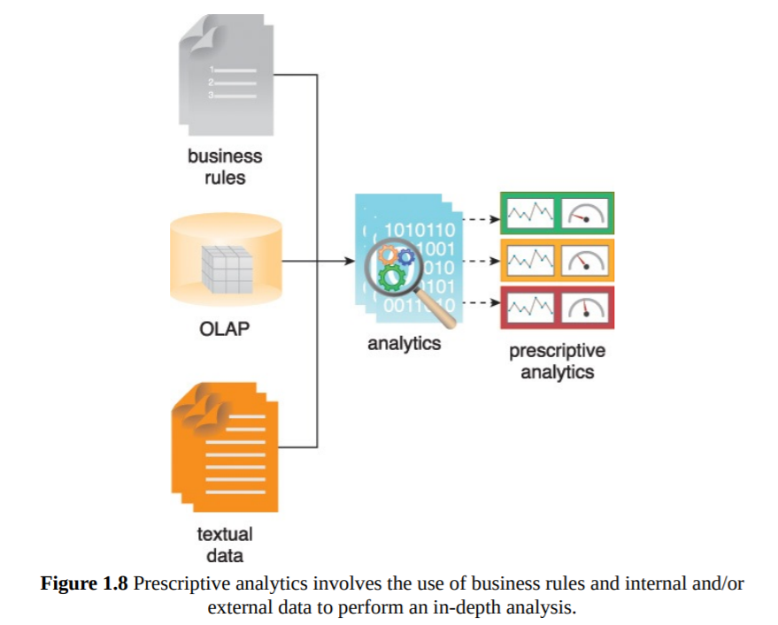
Prescriptive analytics involve the use of business rules and large amounts of internal and external data to simulate outcomes and prescribe the best course of action

Slide 38
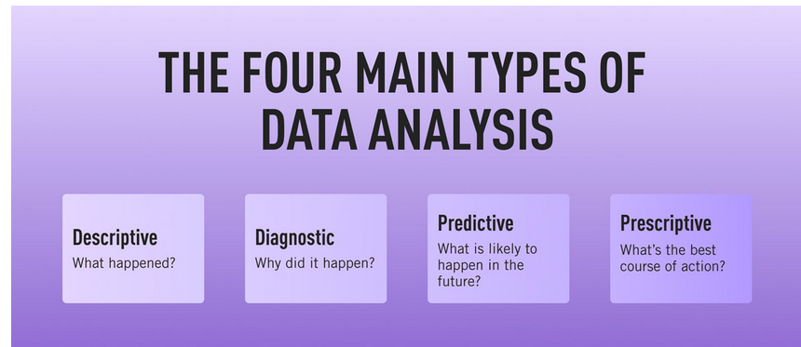

Slide 39
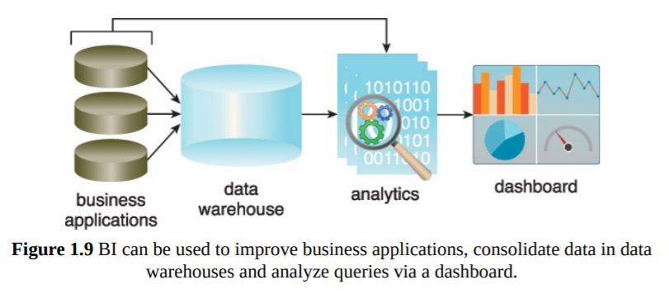
Business Intelligence (BI)
BI enables an organization to gain insight into the performance of an enterprise by analyzing data generated by its business processes and information systems.
BI applies analytics to large amounts of data across the enterprise, which has typically been consolidated into an enterprise data warehouse to run analytical queries.

Slide 40
BI represents the technical infrastructure that collects, stores, and analyzes company data.
BI parses data and produces reports and information that help managers to make better decisions.
Business intelligence (BI) is a technology-driven process for analyzing data and delivering actionable information that helps executives, managers and workers make informed business decisions.
As part of the BI process, organizations collect data from internal IT systems and external sources, prepare it for analysis, run queries against the data and create data visualizations, BI dashboards and reports to make the analytics results available to business users for operational decision-making and strategic planning.
The ultimate goal of BI initiatives is to drive better business decisions that enable organizations to increase revenue, improve operational efficiency and gain competitive advantages over business rivals.
To achieve that goal, BI incorporates a combination of analytics, data management and reporting tools, plus various methodologies for managing and analyzing data.

Slide 41
The steps in the BI process include the following:
data preparation, in which data sets are organized and modeled for analysis;
analytical querying of the prepared data;
distribution of key performance indicators (KPIs) and other findings to business users; and
use of the information to help influence and drive business decisions.

Slide 42
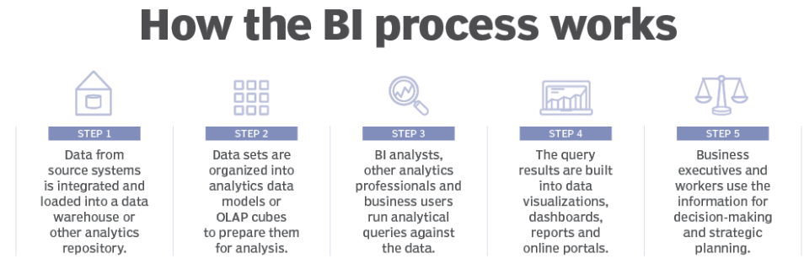

Slide 43
Types of BI Tools and Software
Spreadsheets: Spreadsheets like Microsoft Excel and Google Docs are some of the most widely used BI tools.
Reporting software: Reporting software is used to report, organize, filter, and display data.
Data visualization software: Data visualization software translates datasets into easy-to-read, visually appealing graphical representations to quickly gain insights.
Data mining tools: Data mining tools "mine" large amounts of data for patterns using things like artificial intelligence, machine learning, and statistics.
Online analytical processing (OLAP): OLAP tools allow users to analyze datasets from a wide variety of angles based on different business perspectives.

Slide 44
Key benefits that businesses can get from BI applications
The ability to:
speed up and improve decision-making;
optimize internal business processes;
increase operational efficiency and productivity;
spot business problems that need to be addressed;
identify emerging business and market trends;
develop stronger business strategies;
drive higher sales and new revenues; and
gain a competitive edge over rival companies.

Slide 45
Key Performance Indicator(KPI)
A key performance indicator (KPI) is a measurable value that demonstrates how effectively a company is achieving key business objectives.
Organizations use KPIs to evaluate their progress and success at reaching targets.
In simple terms, a KPI is a goal that you work towards achieving.
Example: you own an apple shop and to be profitable this month, you have to sell 1,000 apples.
KPI: sell 1,000 apples this month.
Whether that’s 250 apples per week or you sell all 1,000 in the first 3 days, your KPI is to reach that 1K mark.
When it’s the second week of September and you’ve sold 550 apples, you can look at your KPI and know that you’re on track to achieve your goal.

Slide 46
A KPI is a metric that can be used to gauge success within a particular business context.
KPIs are linked with an enterprise’s overall strategic goals and objectives.
They are often used to identify business performance
Quantifiable reference points for measuring a specific aspect of a business’ overall performance problems and demonstrate regulatory compliance.

Slide 47
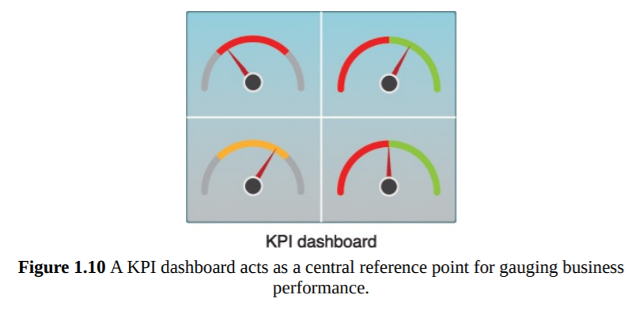
KPIs are often displayed via a KPI dashboard

Slide 48
What makes a good KPI?
SMART framework:
Specific, Measure, Attainable, Relevant, Timeframe
Is your objective specific?
Can you measure progress towards your goal?
Is the goal realistically attainable?
How relevant is the goal to your organization?
What is the timeframe for achieving this goal?

Slide 49
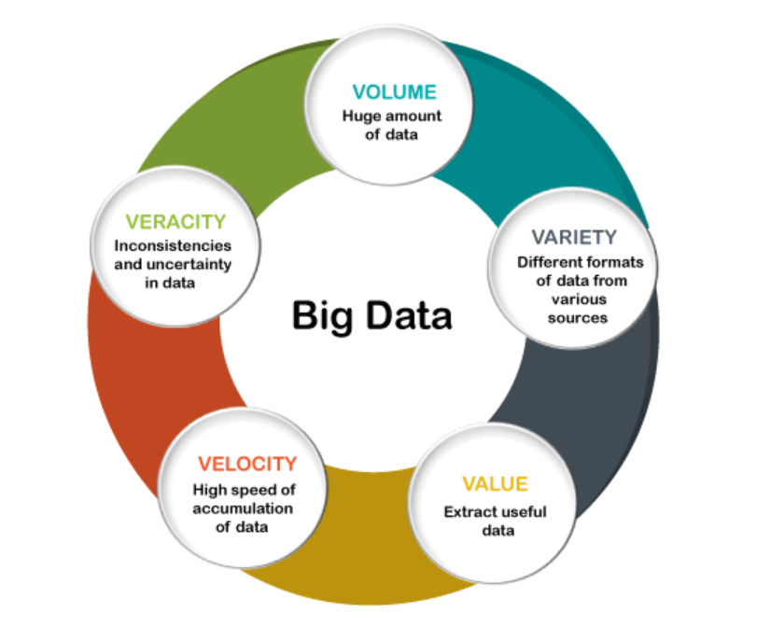
Big Data Characteristics(5 Vs)

Slide 50
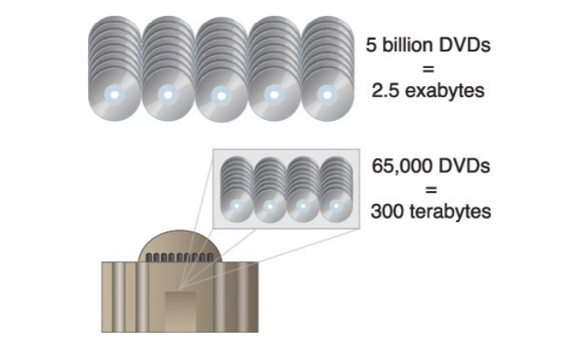
Volume

Slide 51
Typical data sources that are responsible for generating high data volumes can include:
• online transactions, such as point-of-sale and banking
• scientific and research experiments, such as the Large Hadron Collider and Atacama Large Millimeter/Submillimeter Array telescope
• sensors, such as GPS sensors, RFIDs, smart meters and telematics
• social media, such as Facebook and Twitter

Slide 52
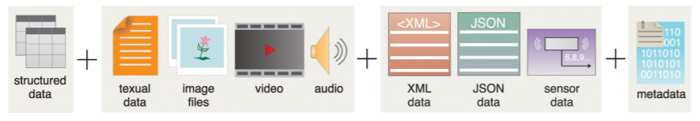

Slide 53
Structural variation of Data in action
In real time scenario, the data we found can be broadly categorize in the basis of its form:
Structured data: conforms to a data model or schema and is often stored in tabular form.
Ex: SQL Table in DBMS
Unstructured Data : Data that does not conform to a data model or data schema is known as unstructured data
Ex: Image, Video, Audio etc.
Semi-structured Data: Semi-structured data has a defined level of structure and consistency, but is not relational in nature
Ex: XML, JSON files, Sensor Data etc.

Slide 54
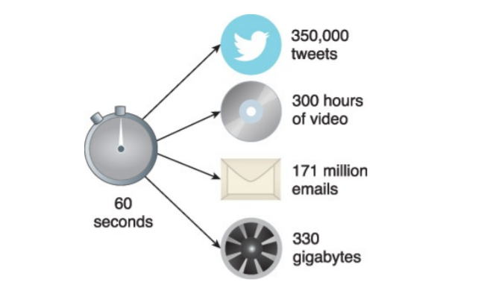
Velocity

Slide 55
Veracity
Veracity refers to the quality or fidelity of data.

Slide 56
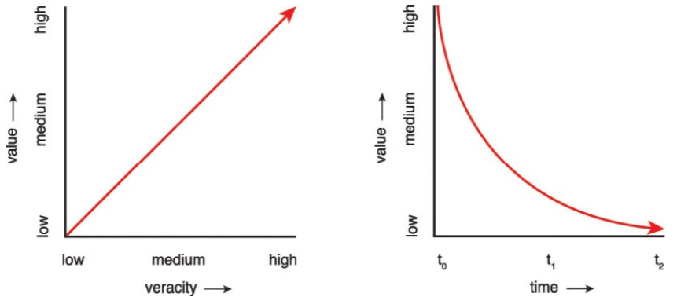
Value
Value is defined as the usefulness of data for an enterprise.
The higher the data fidelity, the more value it holds for the business
Value is also dependent on how long data processing takes

Slide 57
Apart from veracity and time, value is also impacted by the following lifecycle-related concerns:
• How well has the data been stored?
• Were valuable attributes of the data removed during data cleansing?
• Are the right types of questions being asked during data analysis?
• Are the results of the analysis being accurately communicated to the appropriate decision-makers?

Slide 58
Metadata: Metadata provides information about a dataset’s characteristics and structure.
Data About data.
Examples of metadata include:
• XML tags providing the author and creation date of a document
• attributes providing the file size and resolution of a digital photograph
Big Data solutions rely on metadata, particularly when processing semi-structured and unstructured data.

Slide 59
If you have more quriocity you may ask OR follow the following links:
https://www.tutorialspoint.com/big_data_tutorials.htm
https://www.analyticsvidhya.com/blog/2021/05/what-is-big-data-introduction-uses-and-applications/
https://www.coursera.org/learn/big-data-introduction
https://energie.labs.fhv.at/~repe/bigdata/introduction-to-big-data-projects/introduction-to-big-data/
https://intellipaat.com/blog/tutorial/big-data-and-hadoop-tutorial/introduction-to-big-data-2/
https://www.javatpoint.com/what-is-big-data
And many more…

